Slide 1
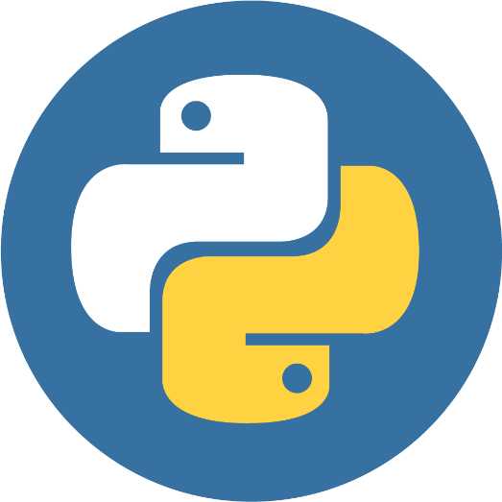
INTRODUCTION TO PYTHON PROGRAMMING
Pasty Asamoah
+233 (0) 546 116 102
Pastyasamoah13@gmail.com | pastyasamoah@knust.edu.gh
Kwame Nkrumah University of Science and Technology
School of Business
Supply Chain and Information Systems Dept.
3MD

Slide 2

Images used in this presentation are sourced from various online platforms. Credit goes to the respective creators and owners. I appreciate the work of the original content creators.

Slide 3
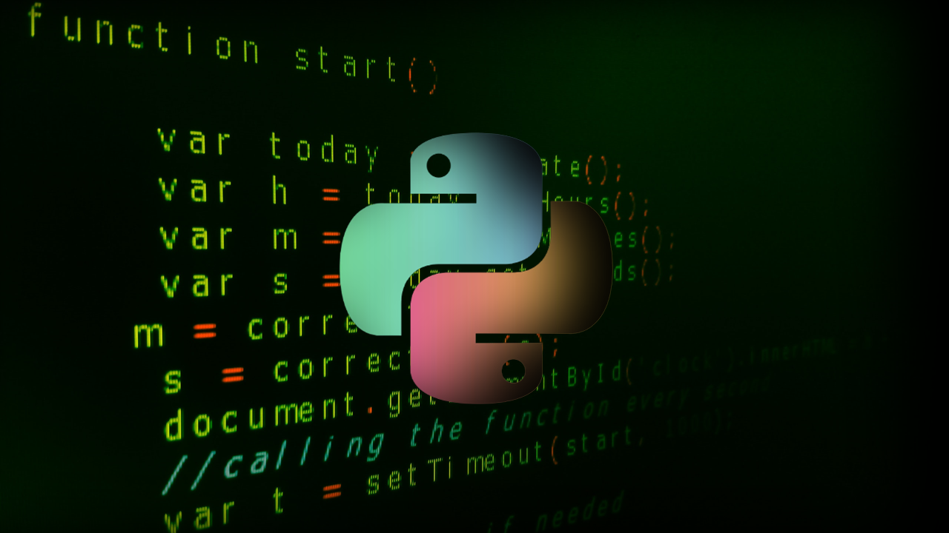
PYTHON PROGRAMMING

Slide 4
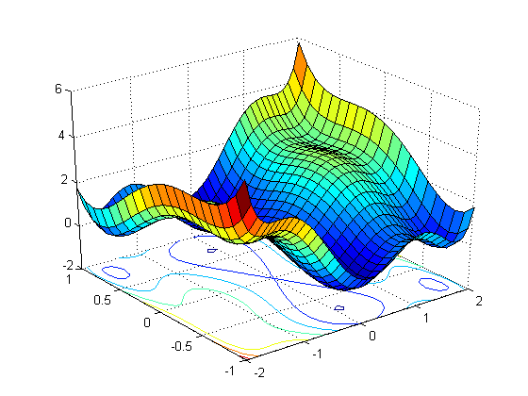

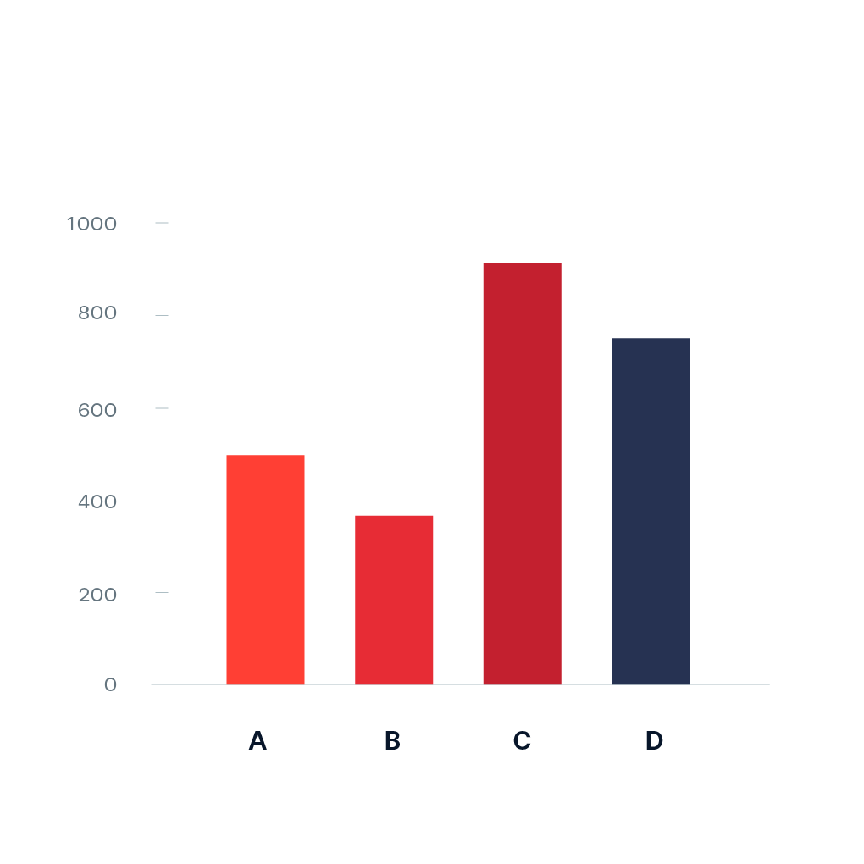
PYTHON – Of course not a snake!
Python is a popular general-purpose programming language created by Guido van Rossum, and released in 1991.
Python can be used for:
Software & Game Development
Data Analytics, Visualizations, and Machine Learning
Scientific Computing

Slide 5
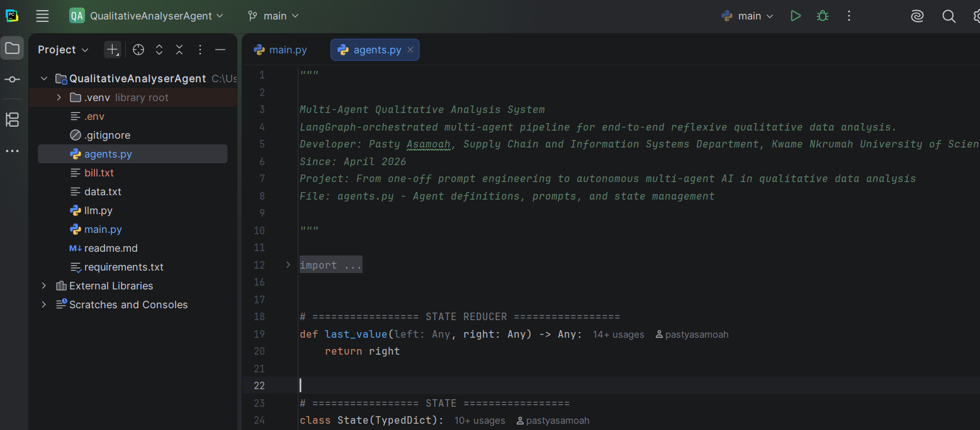


DOWNLOAD & INSTALLATION
Python
Pycharm Community
https://www.python.org/ftp/python/3.12.1/python-3.12.1-amd64.exe
https://www.jetbrains.com/pycharm/download/?section=windows

Slide 6

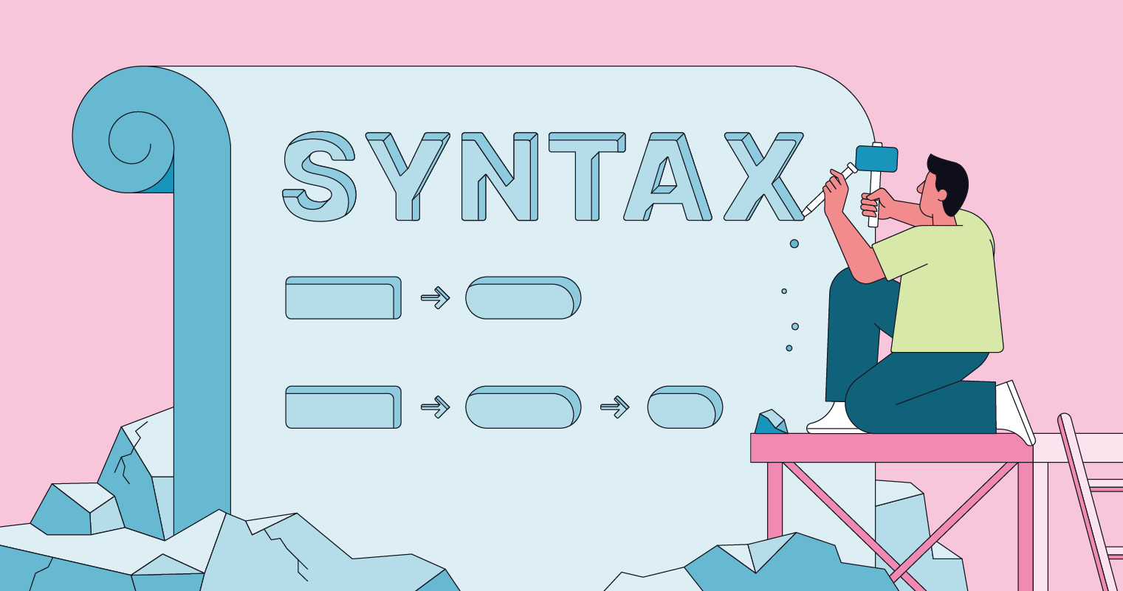

PYTHON SYNTAX
The set of rules that defines how a Python program will be written and interpreted.
Indentation
Defines a block of code
Syntax Error
We’ll discover other important rules as we progress
Credit: w3schools

Slide 7

HELLO WORLD! – Programming Tradition
!!! Notice the absence of a semi-colon after the bracket close

Slide 8
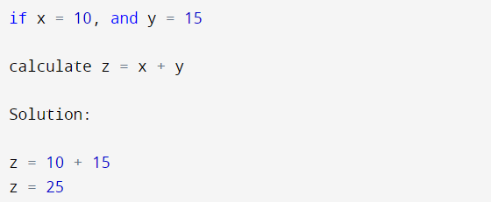
VARIABLES
Variables are containers for storing data values.
Python has no command for declaring a variable.
A variable is created the moment you first assign a value to it.
DO YOU REMEMBER BACK IN HIGH SCHOOL?
These are variables in python

Slide 9
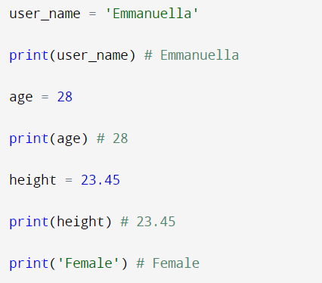
VARIABLES
Variables are containers for storing data values.
Python has no command for declaring a variable.
A variable is created the moment you first assign a value to it.
Notes:
Emmanuella is wrapped in a quotation mark.
Print(username) is not in a quotation mark
Print(‘Female’) is wrapped in a quotation mark

Slide 10
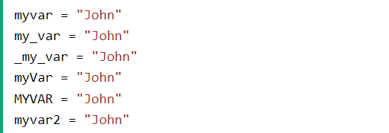

RULES IN NAMING VARIABLES
A variable name:
  must start with a letter or the underscore character
  cannot start with a number
  can only contain alpha-numeric characters and underscores (A-z, 0-9, and _ )
  is case-sensitive (age, Age and AGE are three different variables)
  cannot be any of the Python keywords.
Error but why?
Credit: w3schools

Slide 11
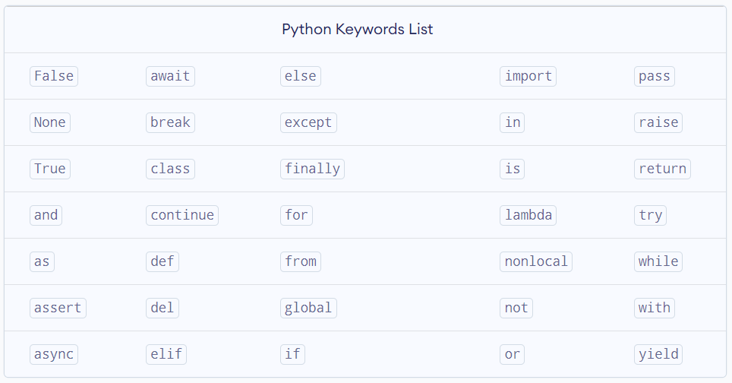
PYTHON KEYWORDS
Keywords are predefined, reserved words used in Python programming that have special meanings to the compiler.
!!! These keywords are reserved for the python programming languages
Credit:programiz

Slide 12
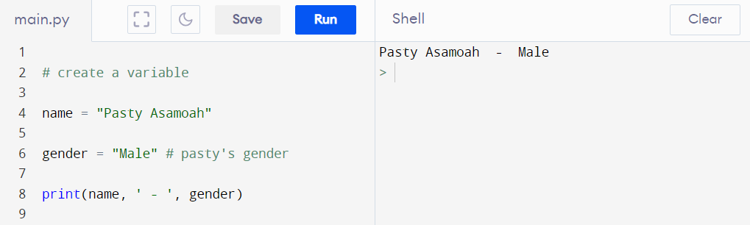
COMMENTS
In computer programming, comments are hints that we use to make our code more understandable. They are completely ignored by the interpreter. In python, we use the # symbol for commenting.
Notes:
Anything after the # symbol is ignored
Comment
Credit: programiz

Slide 13
DATA TYPES

Slide 14
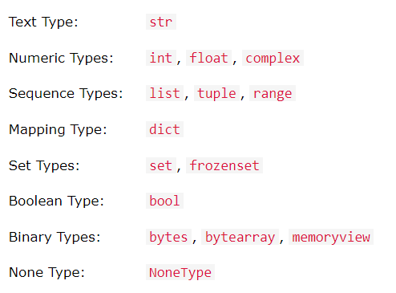
DATA TYPES
In computer programming, data type refers to the type of value a variable holds. The data type of a variable ensures that mathematical, relational or logical operations can be applied without causing an errors. Python supports the following:
Credit: w3schools

Slide 15
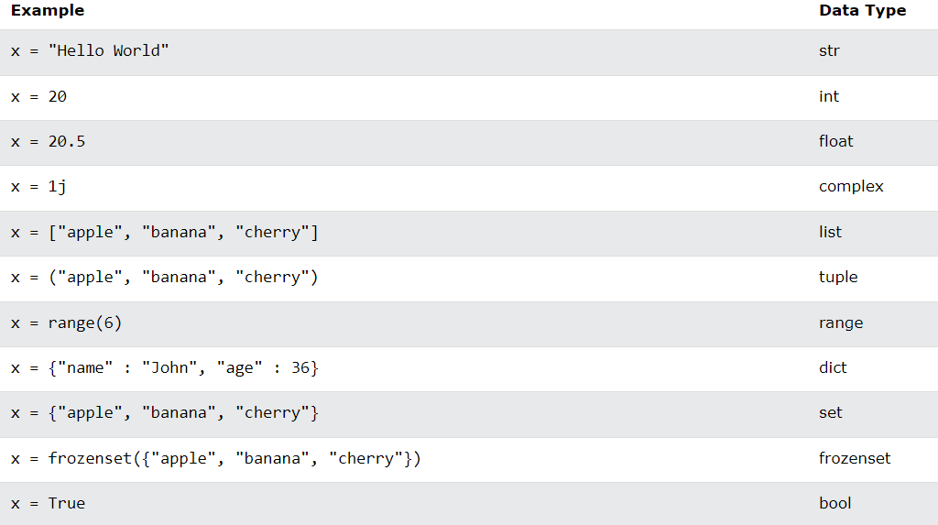
DATA TYPES
Credit: w3schools

Slide 16
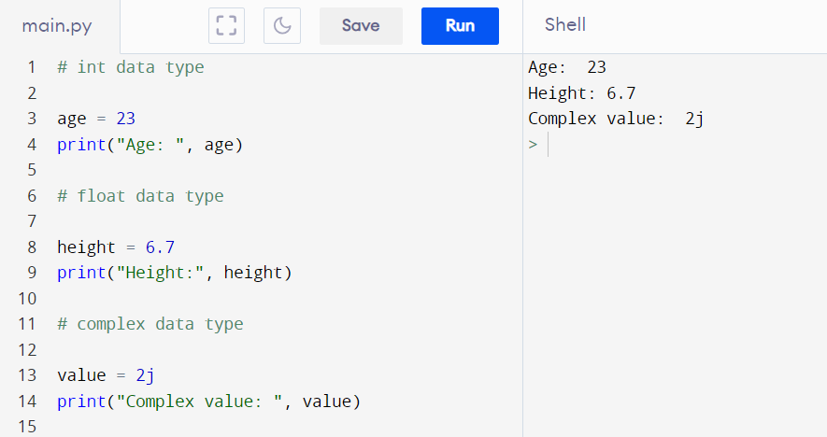
NUMERIC DATA TYPES
Notes:
But how do I know the data type of a variable ?
Concatenation. We can also use the + symbol
Credit: programiz

Slide 17
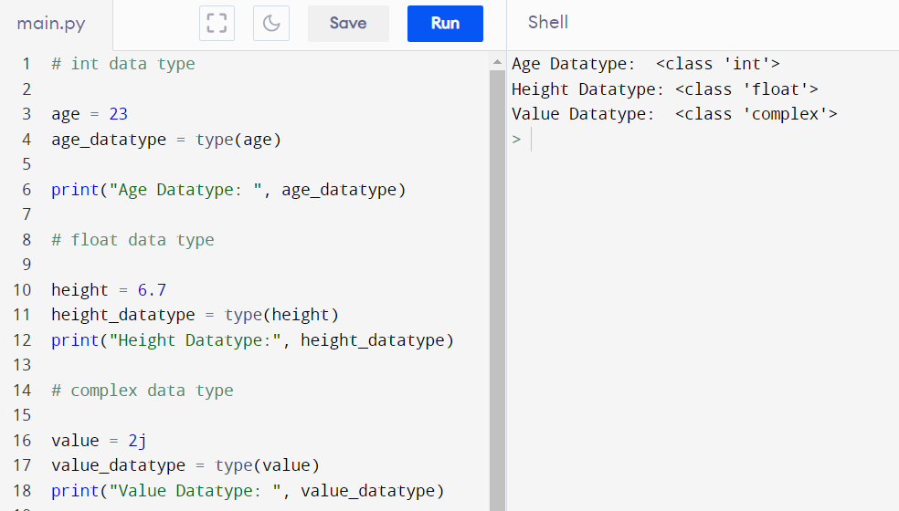
CHECK DATA TYPE
In python programming, to know the data type of a variable, we use the type() function. Of course you don’t know what functions are. We’ll talk about them in moments. For now, understand that we use the type() function to get the data type of a variable.
Notice ‘complex’,’float’, ‘int’
But how do I convert between data types? Well…
Credit: programiz

Slide 18
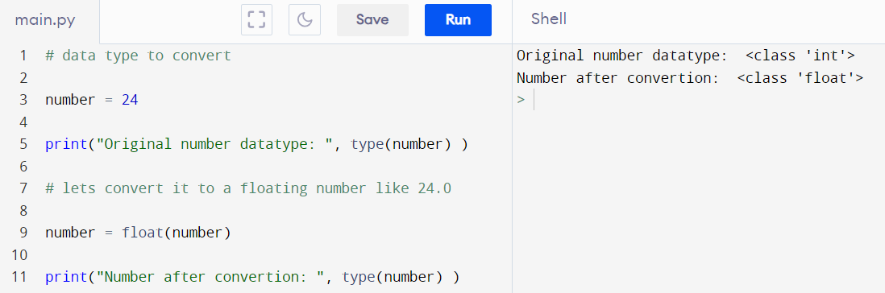
DATA TYPE CONVERTION
We can easily switch between data types. Pay close attention to the results after we checked the data types. They returned something like:
<class ‘int’>. Now, to convert any numeric value to an integer, we use int()
Wrapped in float() function
This applies to converting to int(), float(), complex().
Credit: programiz

Slide 19

Hands-on: 5 mins maximum
Create:
variable X = 23
Variable Y = “12”
Tasks:
Print the data type of X
Print the data type of Y
Compute Z = X+Y such that the result of Z = 35

Slide 20
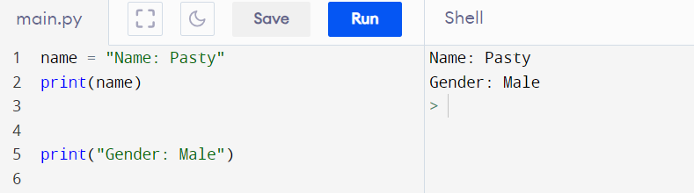
STRING DATA TYPE
In python programming, to know the strings are enclosed in quotation marks “”. For instance, 22 is an integer but “22” is a string. We can use the single or double quotes to create string variables in python
Not in quote
In quote
Credit: programiz

Slide 21
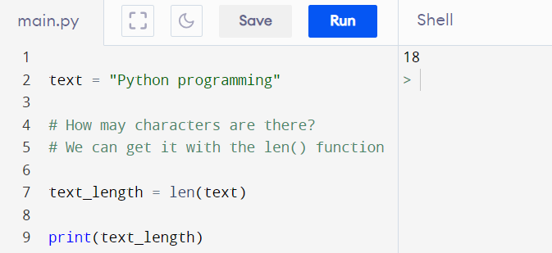
STRING MANIPULATION: LEN()
There are several operations on strings. For instance, we can get the length of the string, slice parts of the string, check values in a string, etc.
18 characters
Len() function counts the number of characters including white spaces
Credit: programiz

Slide 22
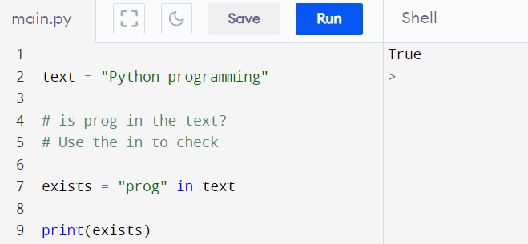
CHECK STRING EXISTENCE: IN
To check if a set of characters are present in the string, we use the IN keyword. The result is a Boolean: True / False
Boolean result
The in keyword to check if the set of characters in a sequential order “prog” exists in the text
Credit: programiz

Slide 23
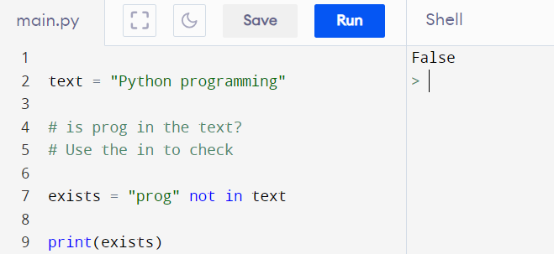
CHECK STRING NOT EXIST: NOT IN
To check if a set of characters are not present in the string, we use the NOT keyword. Basically the NOT keyword is for negation. The result is a Boolean: True / False
Boolean result
The not keyword to check if the set of characters is not in a text.
Credit: programiz

Slide 24
STRING SLICING
Sometimes you may want to slice a portion of a string. Imagine you have the string “Hello world”, but your interest is the text “world”. To slice those characters from the string, we leverage the slicing technique
Text = “Hello world”
-i | -11 | -10 | -9 | -8 | -7 | -6 | -5 | -4 | -3
-2 | -1
+i | 0 | 1 | 2 | 3 | 4 | 5 | 6 | 7 | 8
char | H | e | l | l | o |  | w | o | r
9 | 10
l | d
Variable[start index : end index] # default start and end is 0:0 respectively
The length of your result will always be = end index – start index
Credit: programiz

Slide 25
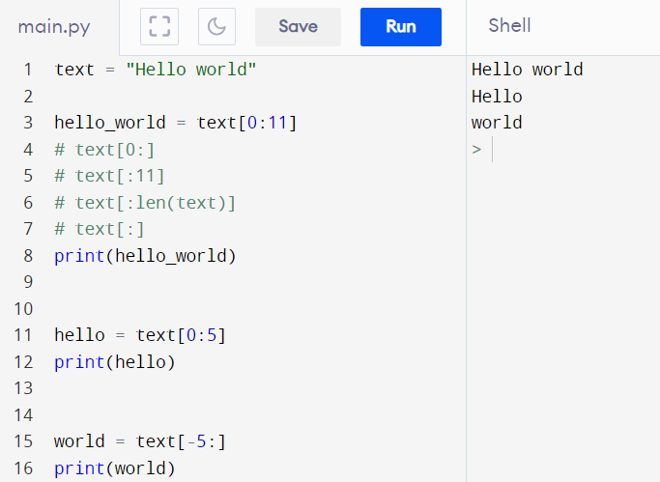
STRING SLICING
From the back, the index starts from -1
Credit: programiz

Slide 26
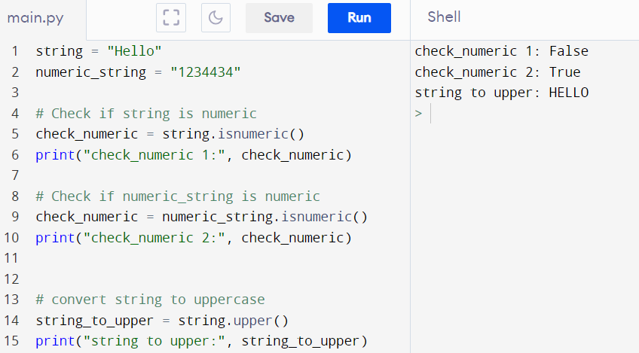
STRING METHODS
There are other several operations we can carry on strings. For instance, we can convert from upper to lower, check if a string is numeric, etc. Kindly find a complete list for your reference at:
https://www.w3schools.com/python/python_strings_methods.asp
Name of the string, dot, method name
Credit: w3schools

Slide 27
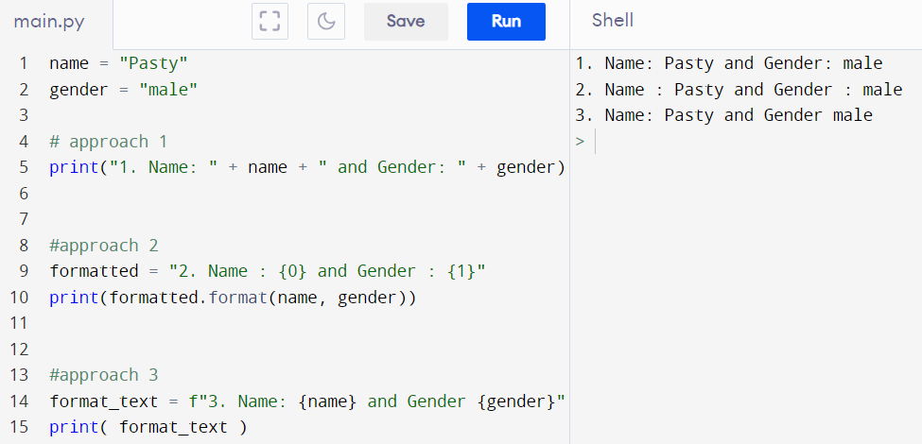
STRING FORMATTING
There are different approaches in formatting string.
Use + to concatenate strings
Use placeholders for the variable names. It matches the positions of the variables used in the format method
Injected the variable names
I will be using the 3rd approach for examples
Credit: w3schools

Slide 28

LIST DATA TYPE
In python programming, lists are used to store multiple items in a single variable. Have you realized we have been creating single items per variable? There are instances where you may need to store more than one item
Variable name
items
List accepts duplicates
0 | 1 | 2 | 3 | 4
apple | banana | cherry | apple | cherry
We can get the length, count items, slice, etc.
Credit: w3schools

Slide 29


REPLACE & ADD TO LIST
Replace
Banana will be replaced with blackcurrant
Index of item to replace
Add
Item to be added to the list
Call the method append() on the name of the list or variable
Credit: w3schools

Slide 30
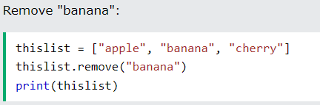
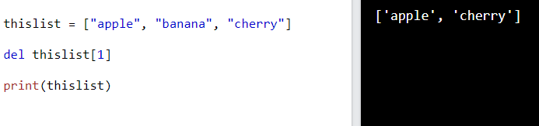
REMOVE FROM LIST
Remove
Call the method remove() on the name of the list or variable
We can also achieve that with the del keyword
Credit: w3schools

Slide 31
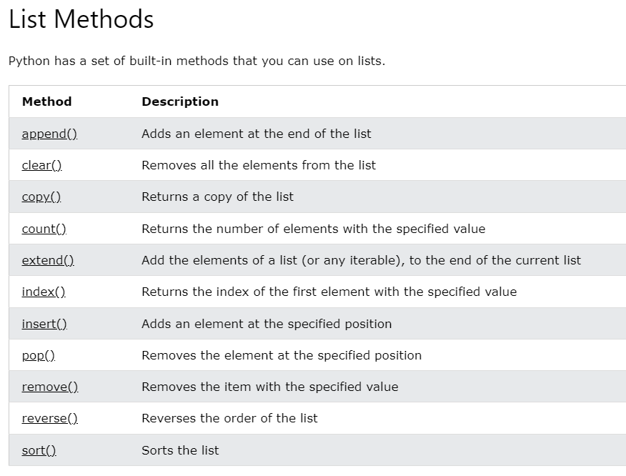
LIST METHODS
Reference: https://www.w3schools.com/python/python_lists_methods.asp
Credit: w3schools

Slide 32

TUPLE DATA TYPE
Tuples are used to store multiple items in a single variable. A tuple is a collection which is ordered and unchangeable. Tuples are written with round brackets.
Variable name
items
How would you add “grapes” to the tuple?
Remember we can convert a tuple to a list, add grapes, and convert it back to tuple!
Tuple Methods Reference: https://www.w3schools.com/python/python_tuples_methods.asp
Credit: w3schools

Slide 33

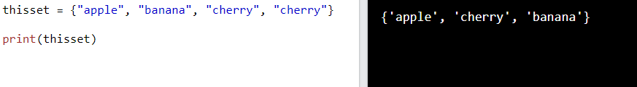
SET DATA TYPE
Sets are unindexed data types used to store multiple items in a single variable. Sets remove duplicates from list of items
Variable name
items
It removed all duplicated values
Credit: w3schools

Slide 34
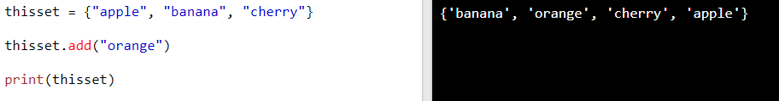
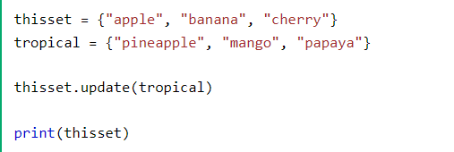
MANIPULATING SETS
ADD
Use the add method
UPDATE
Set 1
Set 2
Call the update method to merge items into a single set
Credit: w3schools

Slide 35
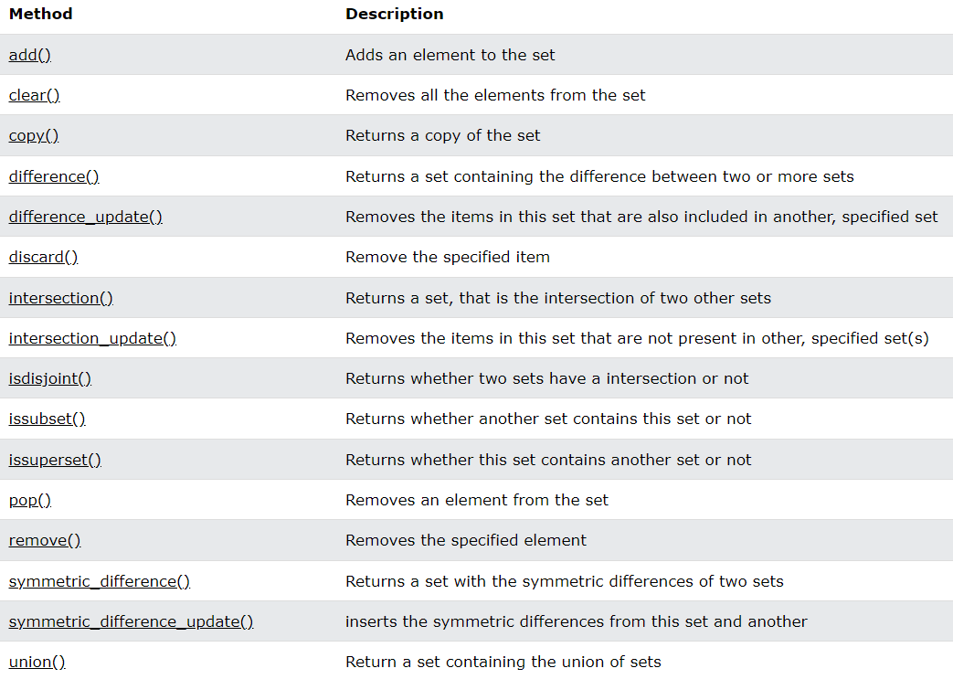
SET METHODS
Reference: https://www.w3schools.com/python/python_sets_methods.asp
Credit: w3schools

Slide 36
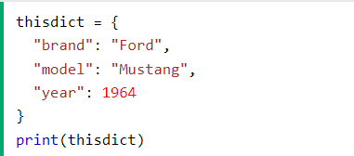
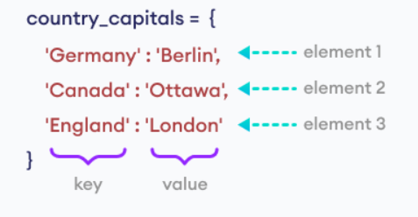
DICTIONARY DATA TYPE
Dictionaries are used to store data values in key:value pairs. Dictionary items are ordered, changeable, and do not allow duplicates.
Values
Use colon
Dictionary keys
We can easily access the car brand as:
thisdict[“brand”]
Credit: w3schools, programiz

Slide 37
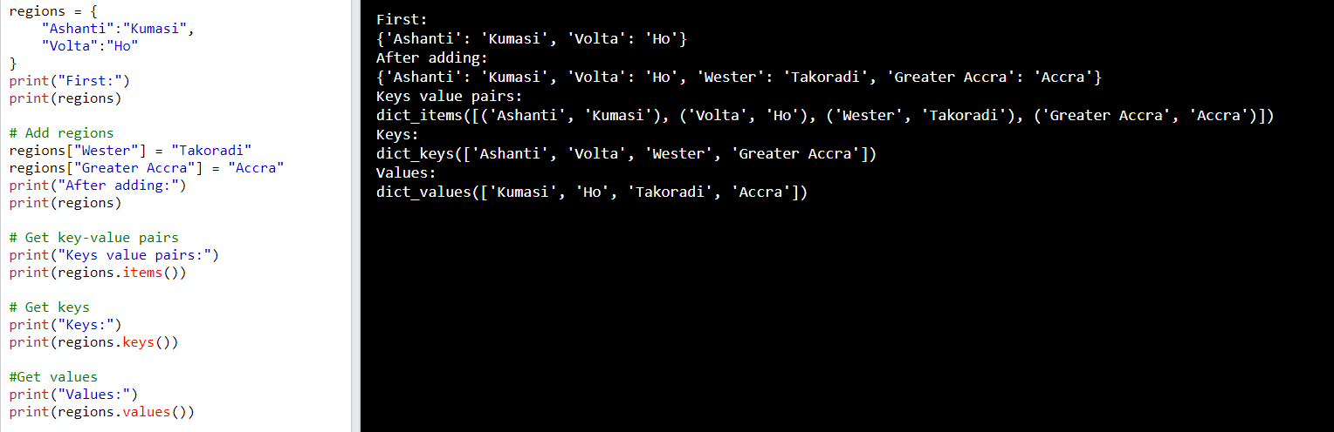
DICTIONARY METHODS
Methods Reference: https://www.w3schools.com/python/python_dictionaries_methods.asp
Credit: w3schools

Slide 38
OPERATORS

Slide 39
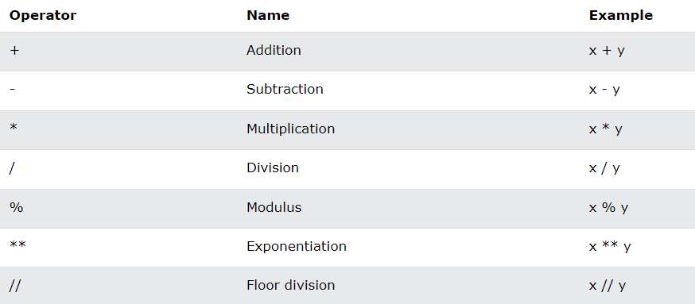

OPERATORS
In programming, operators are used to perform operations on variables and values. There are several of them in python
Arithmetic operators
Assignment operators
Comparison operators
Logical operators
Etc.
Credit: w3schools

Slide 40
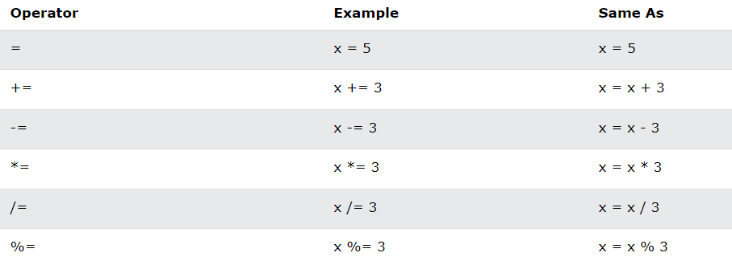
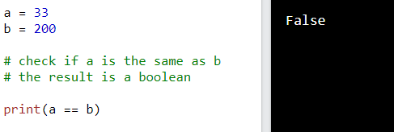
ASSIGNMENT OPERATORS
Assignment operators are used to assign values to variables:
The statement is not true
Credit: w3schools

Slide 41
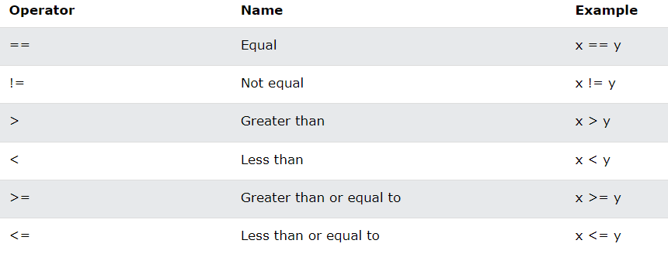
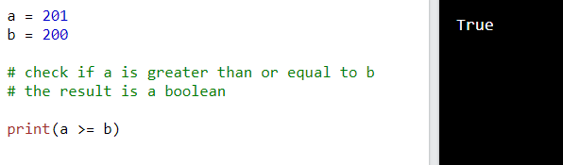
COMPARISON OPERATORS
Comparison operators are used to compare two values
The statement is true
Credit: w3schools

Slide 42
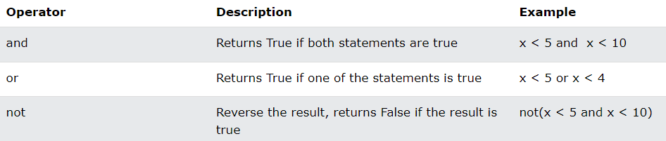
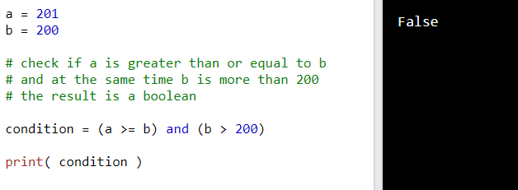
LOGICAL OPERATORS
Logical operators are used to combine conditional statements.
The statement is not true
Credit: w3schools

Slide 43
CONDITIONAL CONTROLS

Slide 44

IF-STATEMENT
In computer programming, the if statement is a conditional statement. It is used to execute a block of code only when a specific condition is met. For example, Suppose we need to assign different grades to students based on their scores:
If a student scores above 90, assign grade A
If a student scores above 75, assign grade B
If a student scores above 65, assign grade C
colon
Indentation
Execute this block of code if and only if the condition is true
Credit: programiz

Slide 45
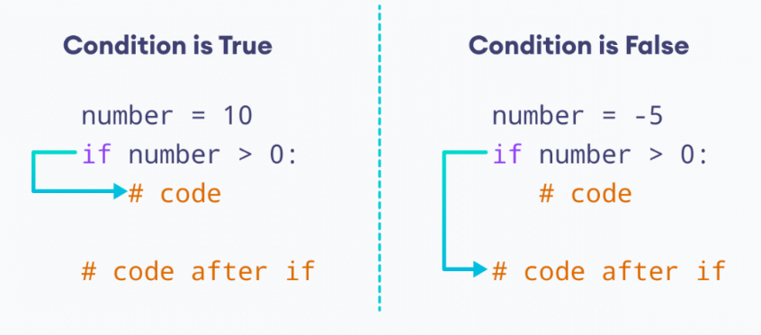
IF-STATEMENT
The logic
Credit: programiz

Slide 46
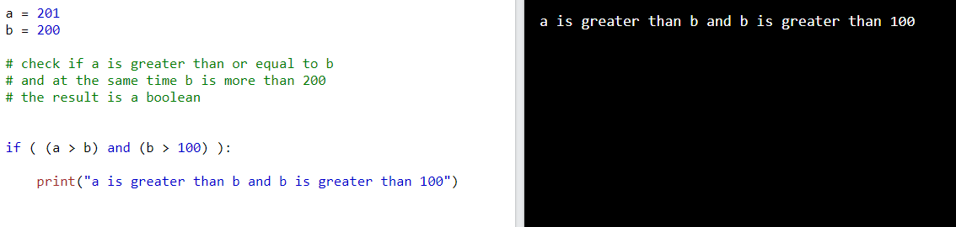
IF-STATEMENT
Pay attention to the little space. Note that the print function is not directly under the “if”. This indicates that, the print statement belongs to the body of the if-statement
But what if the statement or condition returned False?
We can handle that with an else block
Credit: w3schools

Slide 47
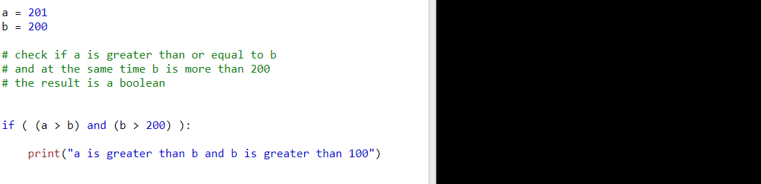
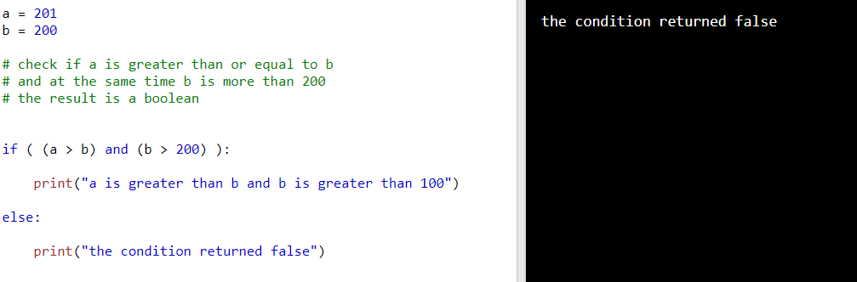
IF-ELSE-STATEMENT
Notice that it did not print anything on the screen. That is because the condition is False. And hence, it did not execute the block. Lets say we want to print some text if the condition is false.
We included the else: block so that if the condition fails, we can still print some text on the screen
Credit: w3schools

Slide 48
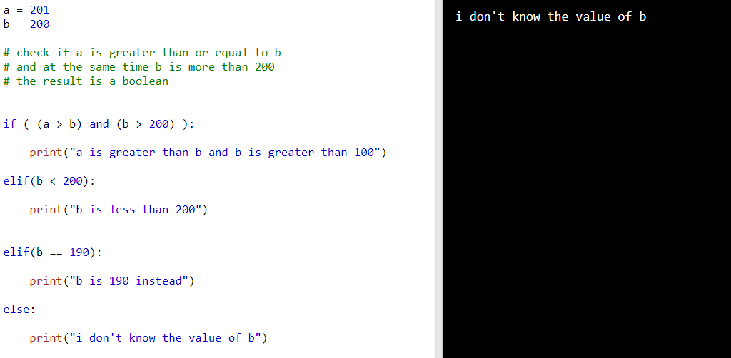
IF-ELIF-STATEMENT
Sometimes you may want to test multiple conditions. In that case, we employ the if-elif statement
We included the elif to check two more conditions. You can add as many as you wish
The else block
Credit: w3schools

Slide 49
LOOPS

Slide 50
LOOPS
In programming, a loop is a control flow statement that is used to repeatedly execute a group of statements as long as the condition is satisfied. Such a type of statement is also known as an iterative statement
Python has two (2) primitive loop commands:
  For loop
  While loop

Slide 51
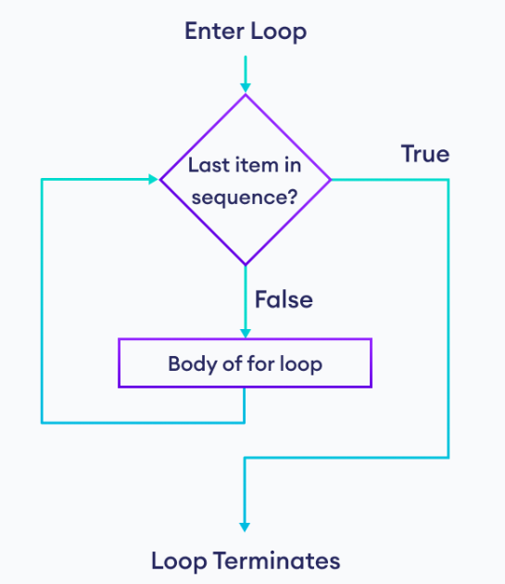
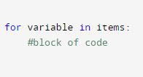
FOR-LOOP
A for loop is used for iterating over a sequence (that is either a list, a tuple, a dictionary, a set, or a string). The python for-loop is less like for-loops in several other programming languages
Credit: programiz

Slide 52



FOR-LOOP
Items to loop through
Variable names. It can be anything
Credit: w3schools

Slide 53
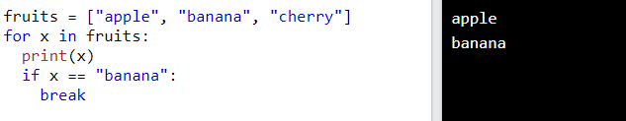
FOR-LOOP: BREAK AND CONTINUE
The break and continue keywords are important for stepping out of the loop and skipping items respectively.
The break keyword in action
If it gets to the condition where fruit is banana, it breaks our of the loop. Meaning, it will not loop through any item after banana
Cherry??
Credit: w3schools

Slide 54
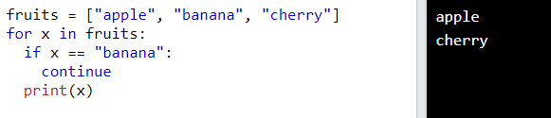
FOR-LOOP: BREAK AND CONTINUE
The break and continue keywords are important for stepping out of the loop and skipping items respectively.
The continue keyword in action
If it gets to the condition where fruit is banana, it skips it. And continue looping over the rest of the items
Banana was skipped
Credit: w3schools

Slide 55
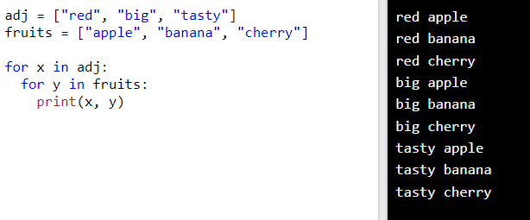
NESTED -FOR-LOOP
Credit: w3schools

Slide 56


WHILE-LOOP
With the while loop we can execute a set of statements as long as a condition is true. The implication is that, we need to keep track of an updating element.
Credit: programiz

Slide 57



WHILE-LOOP
Execute as long as this condition is true
Updates the value of the conditioning item. We will get into an infinite loop without this line of code
The break keyword in action
The continue keyword in action
Check Point
Credit: w3schools

Slide 58
FUNCTIONS

Slide 59



FUNCTIONS
A function is a block of code which only runs when it is called. You can pass data, known as parameters, into a function. A function can return data as a result.
Credit: programiz

Slide 60

FUNCTIONS
Defining and calling a function
Function definition
Calling the function
NB: Until you make a function call, it will never get executed
Credit: w3schools

Slide 61

FUNCTIONS WITH ARGUMENT
Defining functions with argument
Parameter
argument

Slide 62

FUNCTIONS WITH ARGUMENT
Defining functions with argument
Placeholder/ parameter
We append the person name to the Good morning string. This will apply to any name provided as an argument to the function
Function in action.
Credit: w3schools

Slide 63

FUNCTIONS WITH ARGUMENT
Lets modify
Credit: w3schools

Slide 64

FUNCTIONS RETURN VALUES
So far, our functions do not return values that are reusable. We can use the return keyword to achieve that. Note that, functions that return values do not automatically print to the screen.
Returning the sum of the two numbers
No output? But we called the function…
Credit: w3schools

Slide 65

FUNCTIONS RETURN VALUES
So far, our functions do not return values that are reusable. We can use the return keyword to achieve that. Note that, functions that return values do not automatically print to the screen.
Assigning result to a variable. This is possible because we are returning the result after the computation x + y
Print the returned value
Credit: w3schools

Slide 66
OBJECTED-ORIENTED PROGRAMMING (OOP)

Slide 67


CLASS AND OBJECT
Python is an object oriented programming language. Almost everything in Python is an object, with its properties and methods. A Class is like an object constructor, or a "blueprint" for creating objects.
In OOP, everything is considered an Object with certain properties (nouns) and functionalities/methods (verbs).
Credit: programiz

Slide 68

CLASS DEFINITION
It is very simple to create a class in python
Class name
Class properties
Class methods
Credit: programiz

Slide 69

CLASS DEFINITION
Every function requires self. It can be anything. It injects an instance of the class
We are trying to set the name value
We are trying to access the name property using the dot
Credit: programiz

Slide 70

CLASS INSTANTIATION
We could decide to eliminate this code
Creating an instance of the class Human
Calling the method
Setting the human name
Credit: programiz

Slide 71

CLASS CONSTRUCTORS
constructor
We inject the name of the user when instantiating the class
Credit: programiz

Slide 72

CASE
Credit: programiz

Slide 73
MODULES

Slide 74

MODULE
Consider a module to be the same as a code library. It is a file containing a set of functions you want to include in your application. To create a module just save the code you want in a file with the file extension .py
Create a file and name it: mathematics.py
function

Slide 75

MODULE
Create another file in the same directory as the mathematics.py and name it: use.py
Importing the mathematics.py file
Using the add function in the mathematics.py file
Note that we imported all the codes in the mathematics file but we used only the add function.
So lets see how to import only the add function

Slide 76

MODULE
See how we import the add function
See the use too
Sometimes we can import and rename

Slide 77

MODULE
We introduce the “as” aliasing keyword
We access the functions in the mathematics file with mt, the aliase

Slide 78

NEXT STEPS

Slide 79

TO THIS END…
We have learnt the basics of python programming specifically;
  Loops (e.g., for-loop and while-loop)
  Functions
  OOP
  Modules
  In the next session, we will learn about data python framework

Slide 80
READING ASSIGNMENT
Be sure to go through these tutorials for a practical experience on python programming
https://www.programiz.com/python-programming
https://www.w3schools.com/python/
https://www.javatpoint.com/python-tutorial
https://www.youtube.com/watch?v=QXeEoD0pB3E&list=PLsyeobzWxl7poL9JTVyndKe62ieoN-MZ3

Slide 81

NEXT STEPS
Python Frameworks

Slide 82

ANY QUESTIONS??

